Slide 1
Expense Tracker Pitch
Project Name: Expense Tracker
Tagline: "Simplify Your Finances, Amplify Your Savings"
Group Members:
ADEBOYE TOBILOBA JEREMIAH RUN/CMP/22/12796 - HTML aspect
ADEDIRE ISRAEL TEMI RUN/CMP/22/12797 – HTML aspect
ADEGBOLA YANMIFE ADESANYA RUN/CMP/22/12798 – HTML , CSS & JS
ADEGBUSI OLUWAFERANMI BABATUNDE RUN/CMP/22/12799 – HTML & CSS
ADEJARE SHADRACH RUN/CMP/22/12800 – UI/UX Design
ADEKUNLE SAMUEL OLUWAFERANMI RUN/CMP/22/12802 – Javascript aspect
ADELAKUN OLUWADAMILARE ADESILE RUN/CMP/22/12803 – Power Pitching Document
ADELAYI OLUWADOGOBOMI RUN/CMP/22/12988 – README file
ADELEKE DAVID AYOMIDE RUN/CMP/22/12804 – UI/UX Design
ADELEKE MAYOWA SOLOMON RUN/CMP/22/12805 – README file
CSC 312 PROJECT - GROUP 6, SOFTWARE LAB

Slide 2

Problem Statement
The Problem
Who is Affected?
Why This Matters
Many individuals struggle to track and manage their personal finances effectively, leading to poor financial decisions and unexpected budget shortfalls.
Students
Financial management is crucial for personal growth, yet most people lack intuitive tools to understand their spending patterns.
Freelancers
And anyone managing business and personal finances

Slide 3




The Solution
Easily input income and expenses
Quick entry system for all financial transactions
Categorize transactions
Organize spending into meaningful groups
View real-time financial summaries
Instant insights into your financial health
Convert between NGN and USD
Seamless currency conversion for global perspective
Introducing Expense Tracker A user-friendly web application that transforms complex financial tracking into a simple, intuitive experience.
Key Benefits:
Zero learning curve
Instant financial insights
Mobile-friendly design
Privacy-focused (local storage)

Slide 4






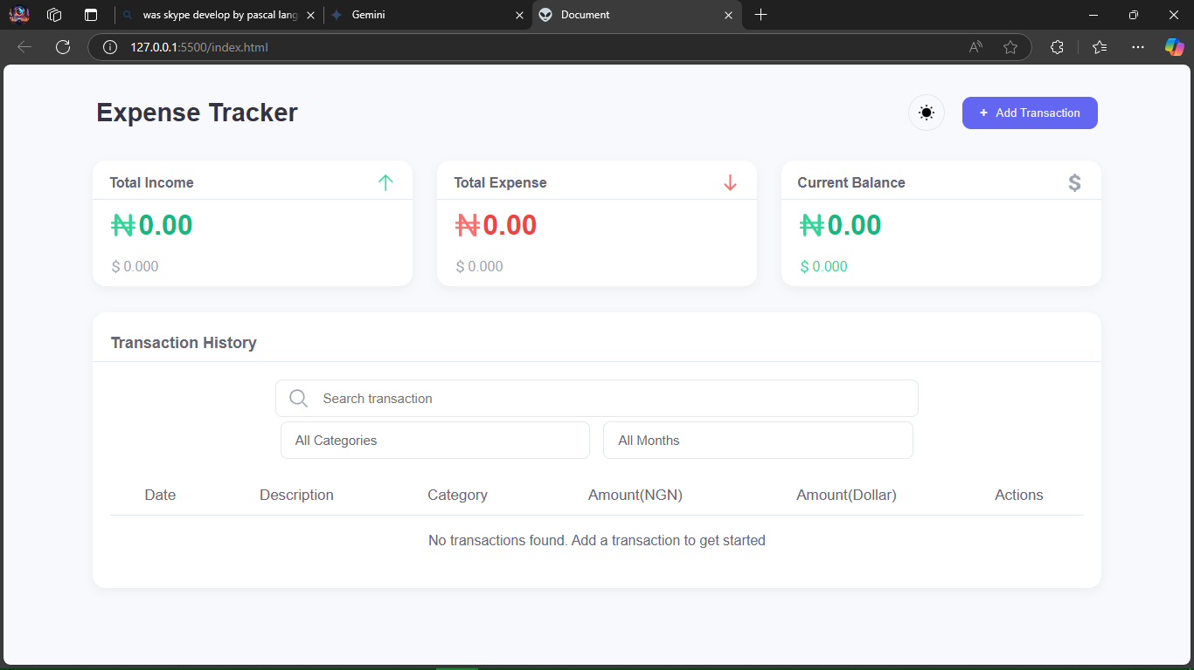
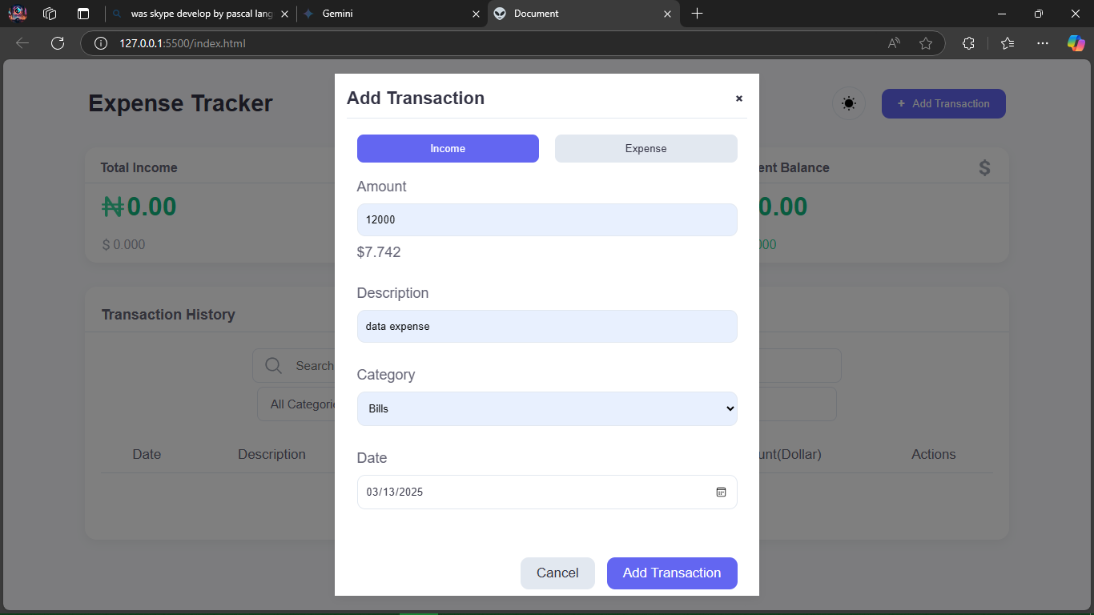
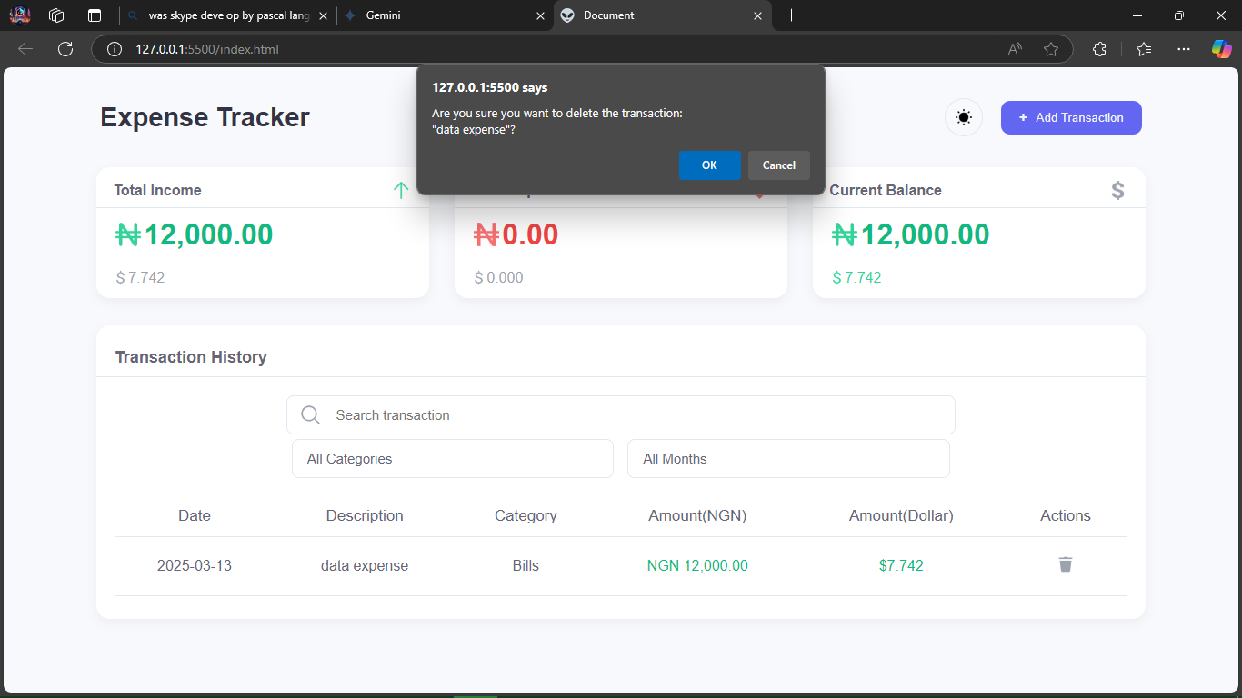
Features & Demo
Transaction logging (income/expense)
Instant balance calculation
Easily record all your financial movements in one place
Always know your current financial standing
Category-based filtering
Dark/Light mode
Analyze spending patterns across different categories
Comfortable viewing experience in any environment
Currency conversion
Search functionality
Switch between NGN and USD with a single click
Quickly find specific transactions when needed
Live Demo Screenshots:

Slide 5
Market Potential & Monetization
Target Users
Monetization Strategies
Students
Freemium model
Entry-level professionals
Optional premium features
Freelancers
Potential for future mobile app version
Budget-conscious individuals
Sponsored financial tips/recommendations
Our market research indicates strong demand for intuitive financial tools among young adults and professionals who are just beginning to manage their finances independently. The freemium model allows us to build a large user base while generating revenue through premium features.

Slide 6





Technology Stack
HTML
CSS
JavaScript
Local Storage
Modern semantic markup for robust structure
Advanced styling with responsive design principles
Pure JS implementation for optimal performance
Client-side data persistence for privacy and speed
Unique Technical Implementations:
Responsive design
Dynamic theme switching
Real-time currency conversion
Local data persistence

Slide 7










Future Improvements
AI-powered spending insights
Smart recommendations based on spending patterns
Mobile app development
Native applications for iOS and Android
Charts and Graphs for Analytics
Visual representations of financial data
Advanced reporting
Detailed financial analysis and projections
Investment tracking & Bill reminders
Expanded financial management capabilities
Long-Term Vision: Become the go-to personal finance management tool for young professionals and students.

Slide 8








Conclusion
Simplify
Visualize
Make financial tracking effortless
See your finances clearly
Save
Optimize
Achieve your financial goals
Improve spending habits
Expense Tracker transforms financial complexity into simple, actionable insights.
CTA: "Invest in your financial future, one transaction at a time!"
Thank You!

